Slide 1
Module 7: Kafka Streams
JVA-083

Slide 2

When to use streaming?
Kafka Streams
credit card fraud detection
marathon race with sensors
stock prices analytics
intrusion detection

Slide 3
When to NOT use streaming?
Kafka Streams
In-depth analysis
Compiling large quantities of data for further analysis
Batching would be far better for that.

Slide 4
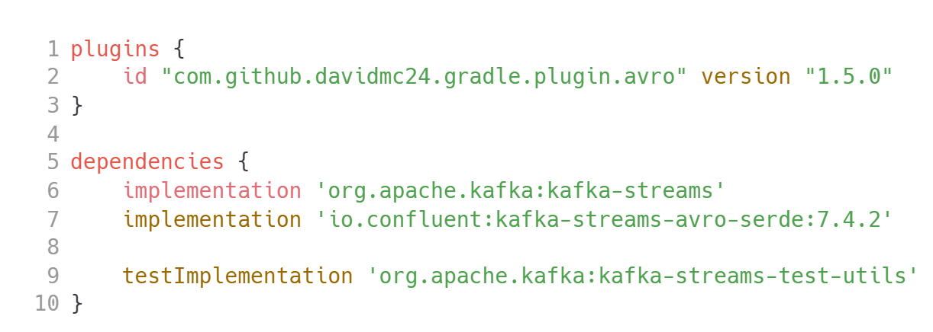
Initial setup
Kafka Streams

Slide 5
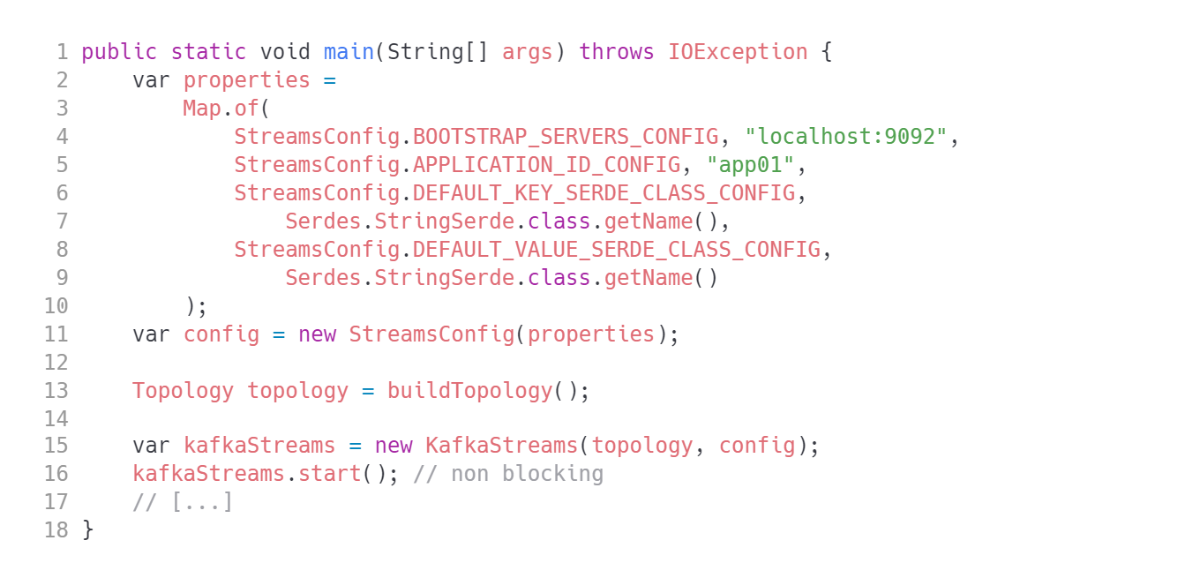
The simplest Kafka Streams application
Kafka Streams

Slide 6
What is a stream topology?
Kafka Streams
A processor topology defines the stream processing computational logic for your application, i.e., how input data is transformed into output data. A topology is a graph of stream processors (nodes) that are connected by streams (edges) or shared state stores. There are two special processors in the topology:
Source Processor: A source processor is a special type of stream processor that does not have any upstream processors. It produces an input stream to its topology from one or multiple Kafka topics by consuming records from these topics and forward them to its down-stream processors.
Sink Processor: A sink processor is a special type of stream processor that does not have down-stream processors. It sends any received records from its up-stream processors to a specified Kafka topic.

Slide 7
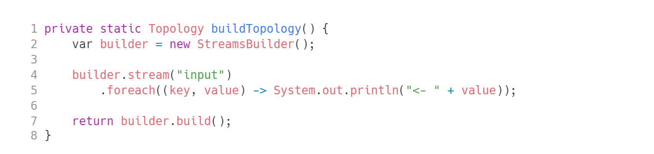
The simplest topology
Kafka Streams
TIP: Look at com.luxoft.lmd.kafka.Ex01SimplestApp and com.luxoft.lmd.kafka.Ex02SimplestApp

Slide 8
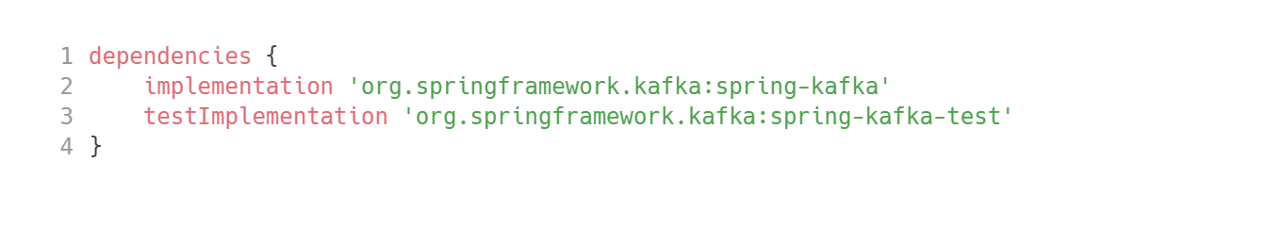
We all prefer Spring for Kafka
Kafka Streams
Let’s setup a Spring Boot based project

Slide 9
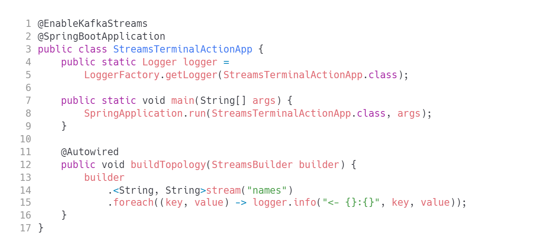
Spring For Kafka
Kafka Streams
CAUTION: do not call builder.build() - this is Spring's job.

Slide 10
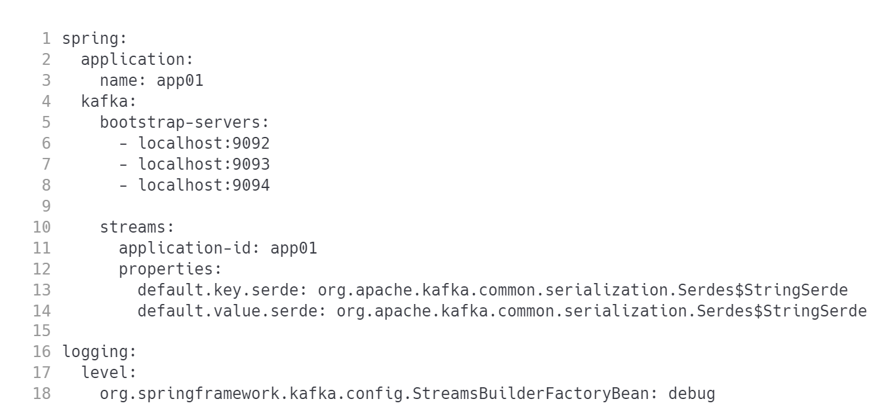
Spring For Kafka - config
Kafka Streams

Slide 11
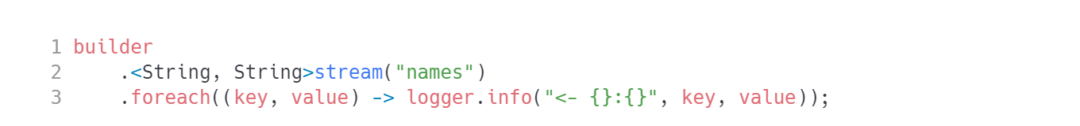
Terminal action
Kafka Streams

Slide 12
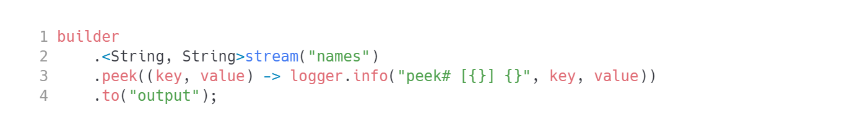
The simplest data pipeline
Kafka Streams
Just copy the data

Slide 13
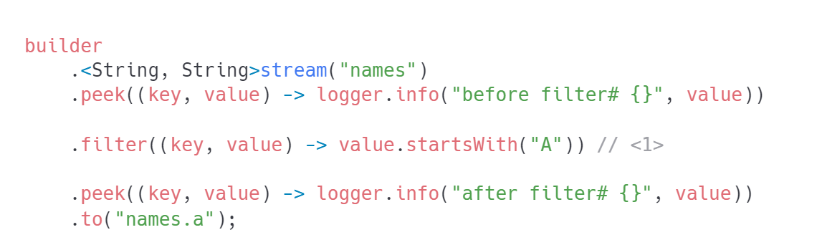
Filtering
Kafka Streams
The most common operation on the planet

Slide 14
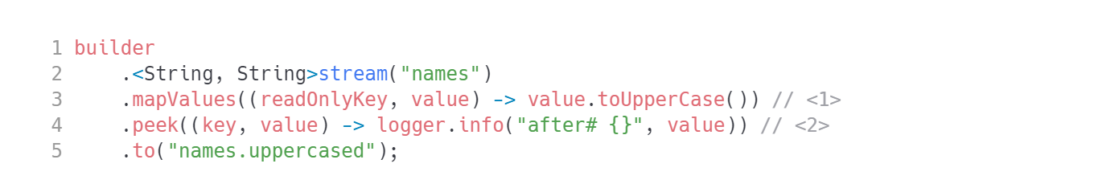
Modifying record value
Kafka Streams
mapping function
peek the transformed value
WARNING: make sure the original key and value stay intact! You are not allowed to modify those!

Slide 15
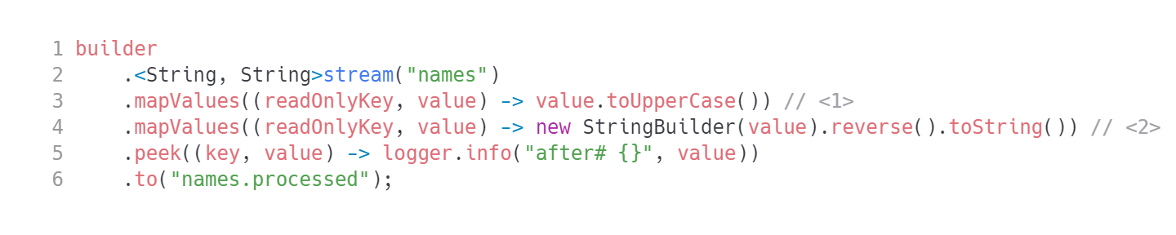
Map values how many times you want
Kafka Streams
It's easy to create multiple processing steps
Lambdas are fine for small, simple functionality. For anything more elaborate simply implement org.apache.kafka.streams.kstream.ValueMapperWithKey interface.

Slide 16
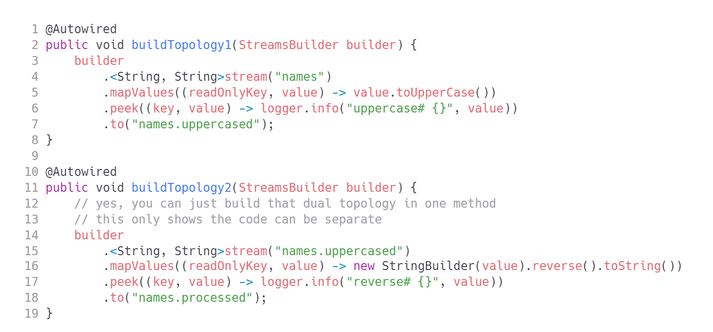
Multiple separate streams
Kafka Streams
TIP: Those as well could be different apps.

Slide 17
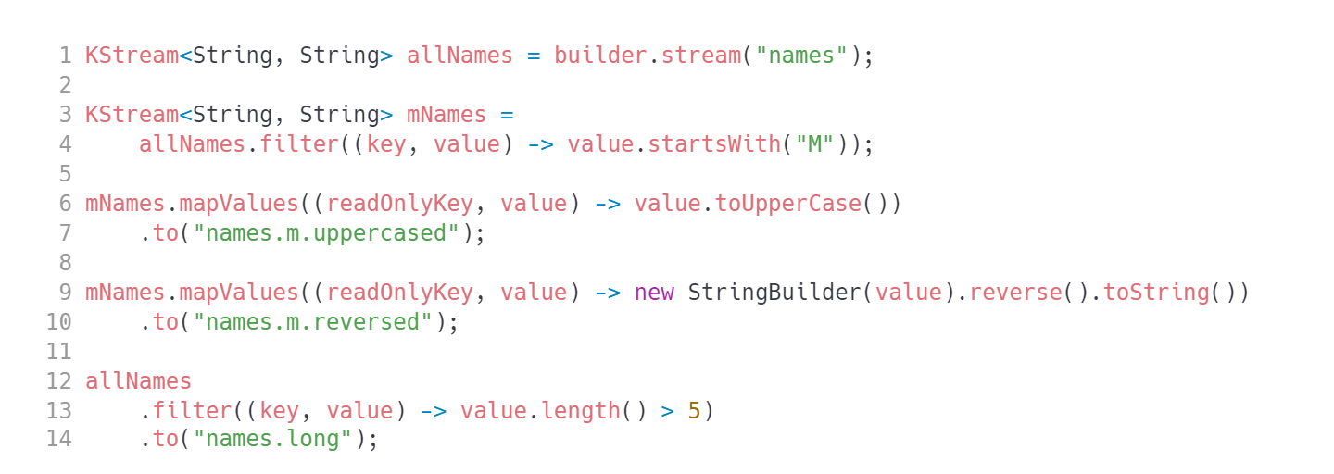
Complex topology graph
Kafka Streams

Slide 18
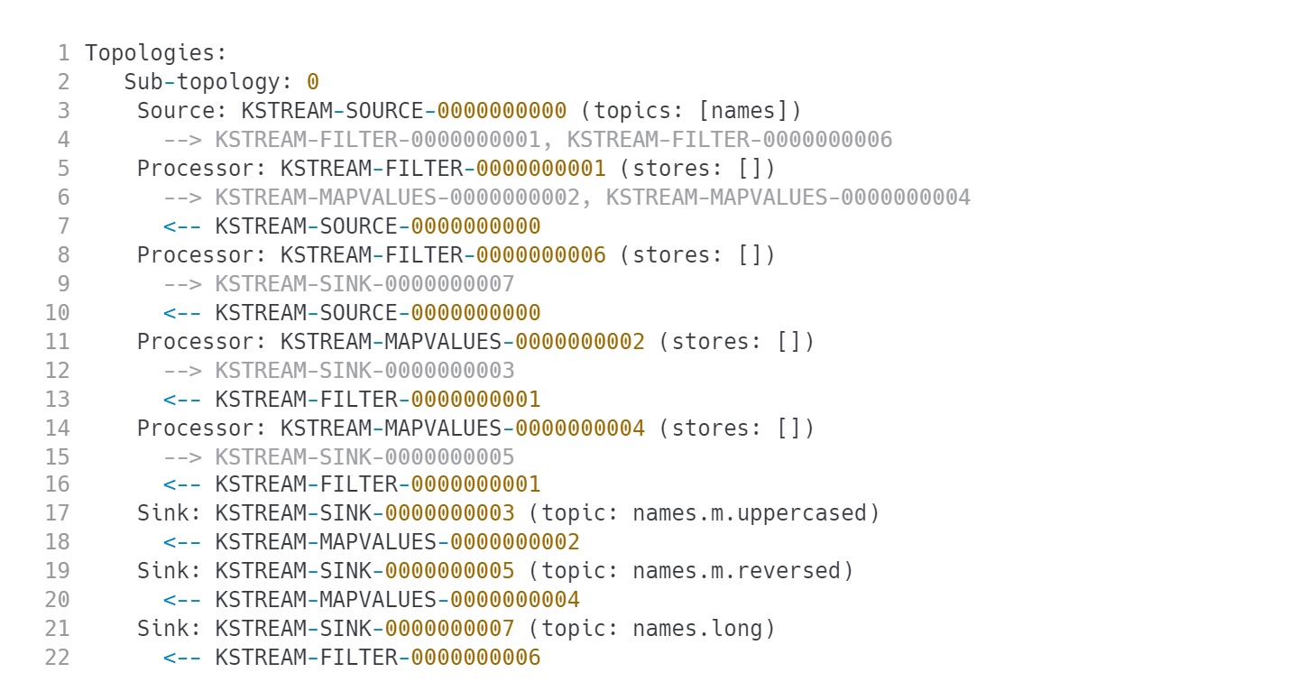
Topology graph is very hard to understand from code
Kafka Streams
Let’s find out if logs can help us
?

Slide 19
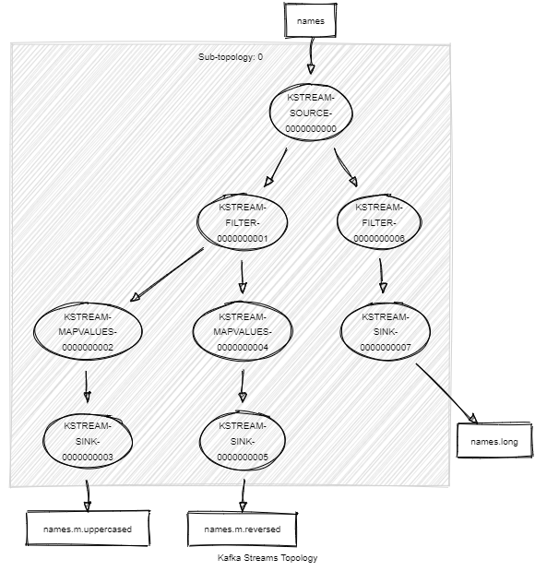
Visualize the topology
Kafka Streams
https://gaetancollaud.github.io/kafka-streams-visualization/
https://zz85.github.io/kafka-streams-viz/
:)

Slide 20
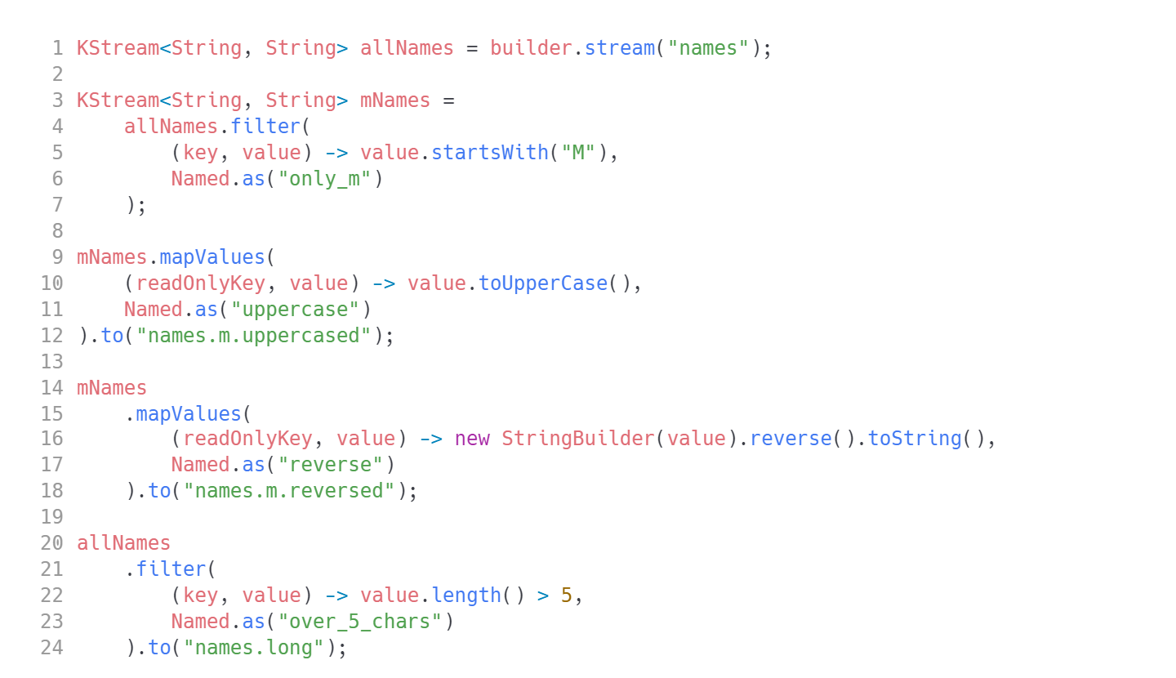
Let’s name the nodes
Kafka Streams
Now it’s just convenient. Later it will become crucial

Slide 21
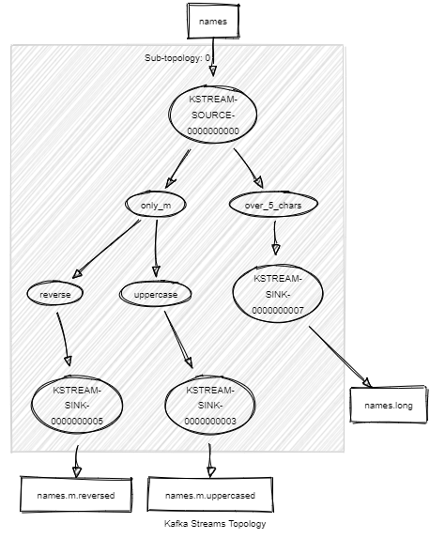
Visualize again
Kafka Streams
WAY BETTER!

Slide 22
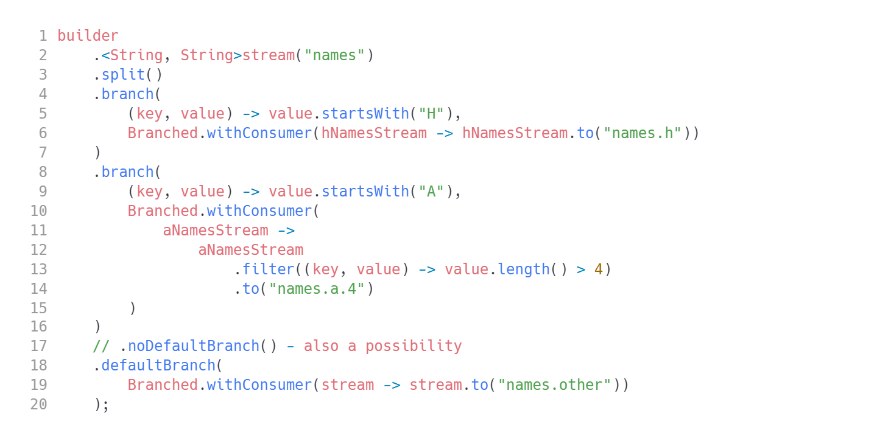
Branching
Kafka Streams
WARNING: The event flows to first matched branch
TIP: use .filter() to direct the event to multiple children

Slide 23
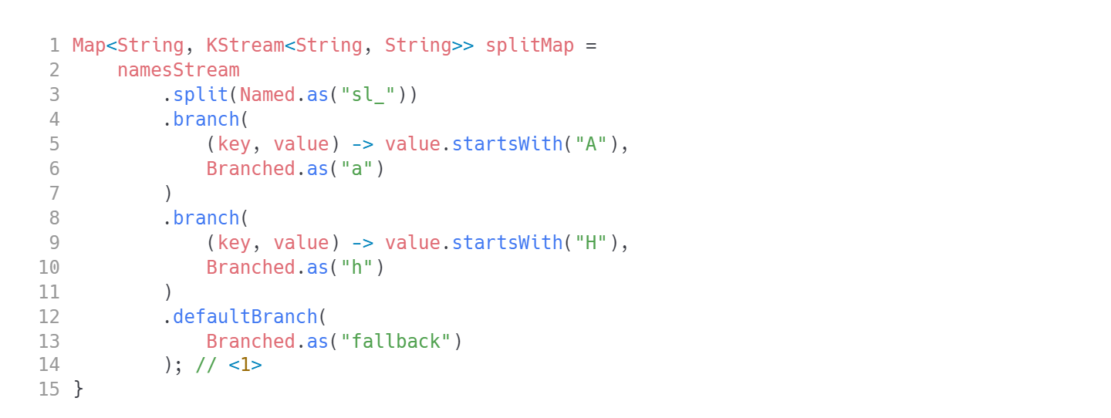
Branching for complex streams
Kafka Streams
1. process the streams from the output map. The keys in map are: "sl_fallback" (default), "sl_A", "sh_H"

Slide 24
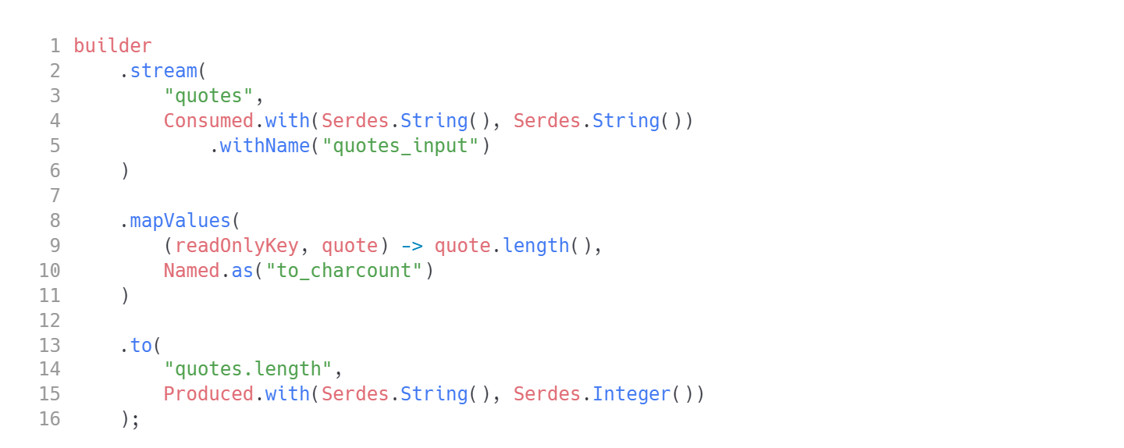
Change the data type down the stream
Kafka Streams
We have to start dealing with deserialization/serialization.

Slide 25
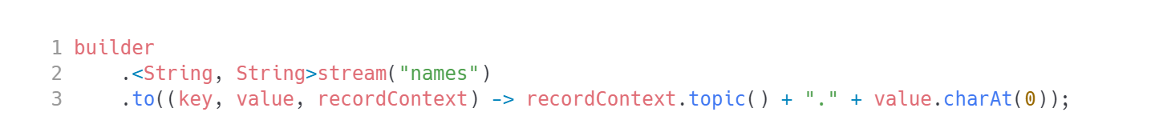
Choosing output topic name
Kafka Streams
org.apache.kafka.streams.processor.TopicNameExtractor

Slide 26
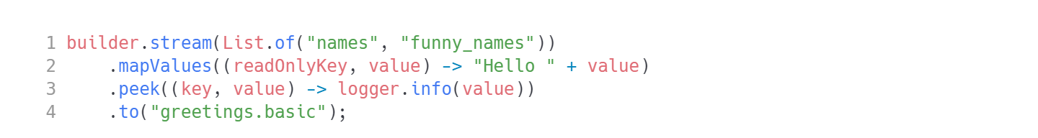
What was branched may come together: merging
Kafka Streams
Simple merging is just consuming multiple topics into one stream

Slide 27
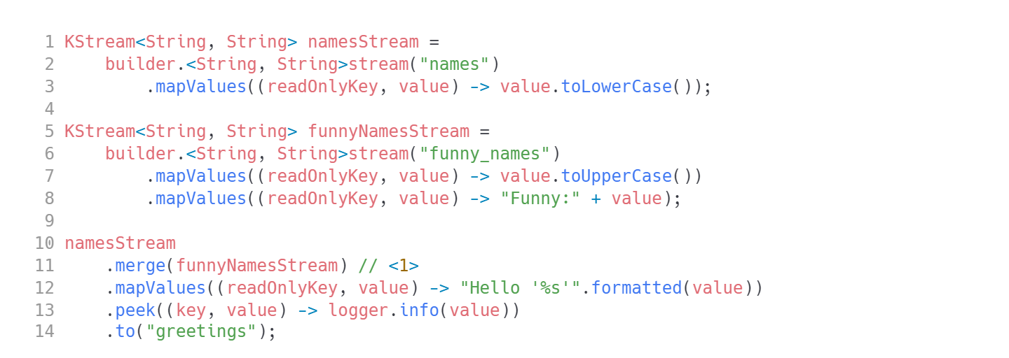
Complex merging
Kafka Streams
1. Merge two prepared streams together for common processing later on.

Slide 28
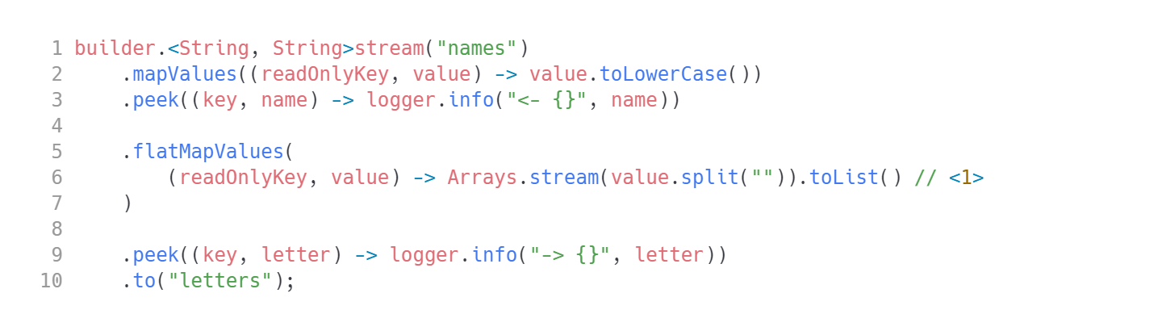
Multiple output records from one input record
Kafka Streams
flatMapValues()
1. Return a collection of new values. All of them will share the same key.
WARNING: Do not mistake flatMapValues with flatMap!

Slide 29
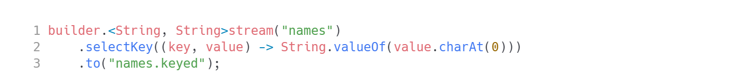
Changing the keys
Kafka Streams
WARNING: Setting the key might result in internal data redistribution.
TIP: Repartitioning is automatic, but it does not come for free!

Slide 30
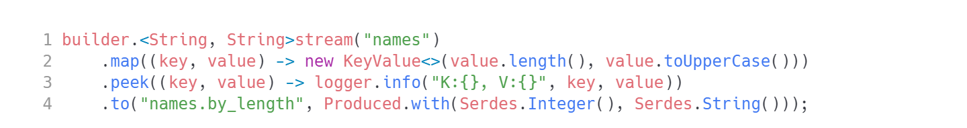
Changing the keys and values simultaneously
Kafka Streams
map()
WARNING: use mapValues() whenever you can!

Slide 31
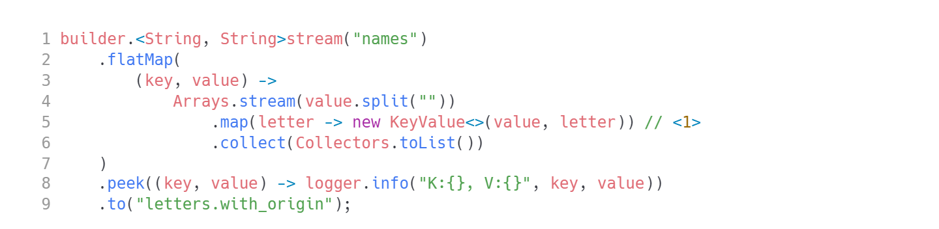
If there is a map(), there should be flatMap()
Kafka Streams
flatMap()
1. Return a collection of KeyValue objects. This way each new record can have a different key.

Slide 32
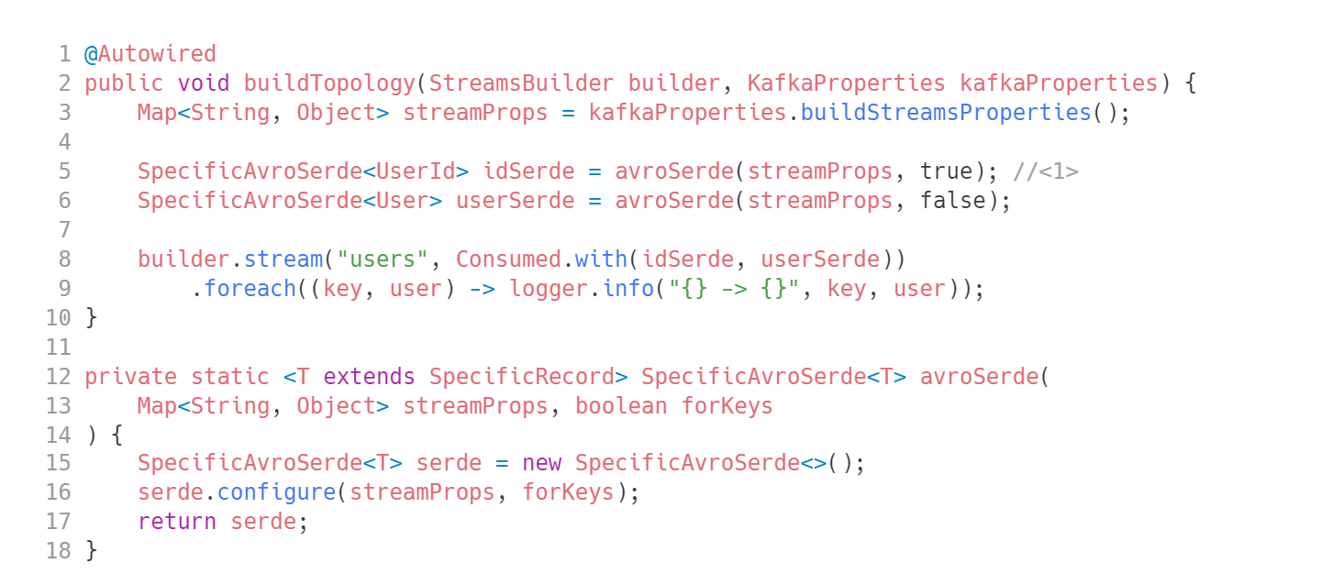
Avro support
Kafka Streams
1. Your serde needs to know if it will be serializing keys or values.
TIP: Add a project dependency: 'io.confluent:kafka-streams-avro-serde:7.4.2'

Slide 33
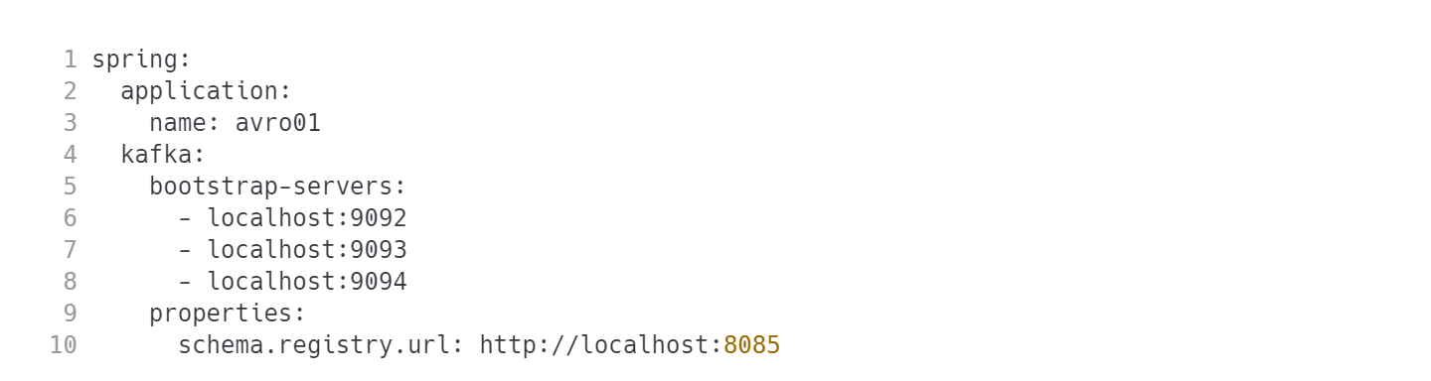
Avro support
Kafka Streams
application.yml

Slide 34
Stateful processing DSL API
Kafka Streams
High level methods to deal with stateful processing

Slide 35
Aggregations
Kafka Streams
An aggregation operation takes one input stream or table, and yields a new table by combining multiple input records into a single output record.
Examples of aggregations are computing counts or sum.
This is a complex operation. Back to the drawing board!

Slide 36

Grouping API
Kafka Streams
Records with `null` key will be dropped!
make sure your records have keys, or
.selectKey(), or
use .groupBy()

Slide 37

Grouping API
Kafka Streams
We need to do something with results of grouping. What?
Count them
Reduce them
Aggregate them

Slide 38
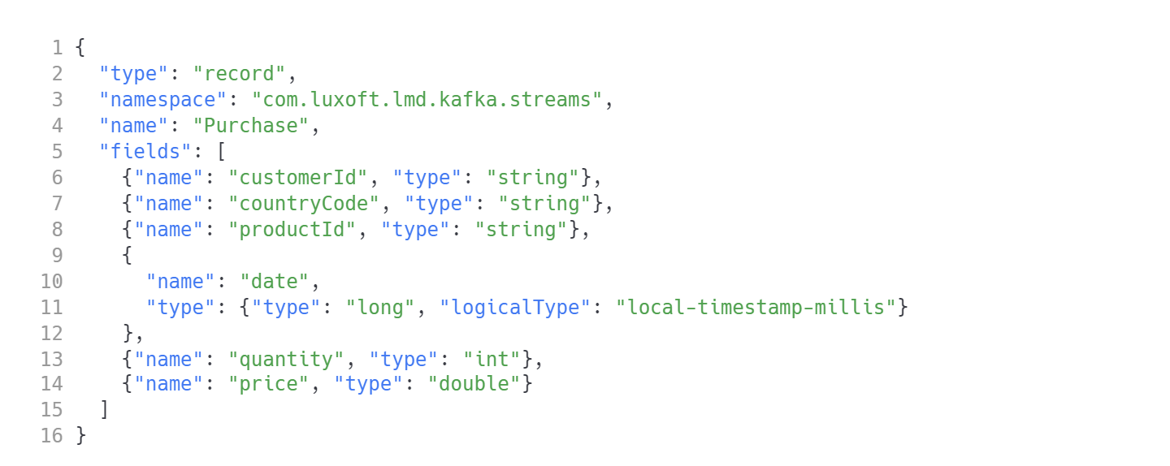
Grouping: real life example
Kafka Streams
Let's assume we have a topic with Avro based purchase records.
NOTE: customerId will be additionally the key of those messages.

Slide 39
Grouping example - requirements
Kafka Streams
count the number of purchases by customer
count the number of purchases by country
calculate total purchase value for each customer
calculate total purchase value and quantity sold for each product

Slide 40
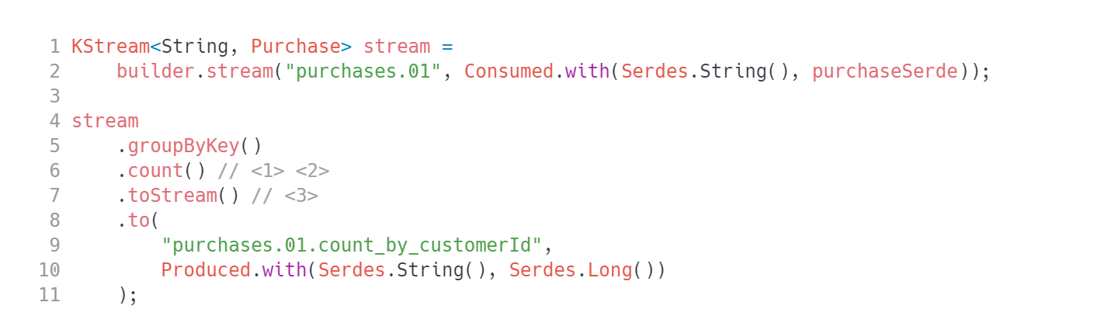
Grouping example 1
Kafka Streams
Count the number of purchases by customer
1.This operation is stateful so it introduces a state store. You can access that state store externally.
2. This operation creates a KTable customerId -> countOfPurchases.
3. Convert the KTable to a new stream which could be serialized to some new topic.

Slide 41
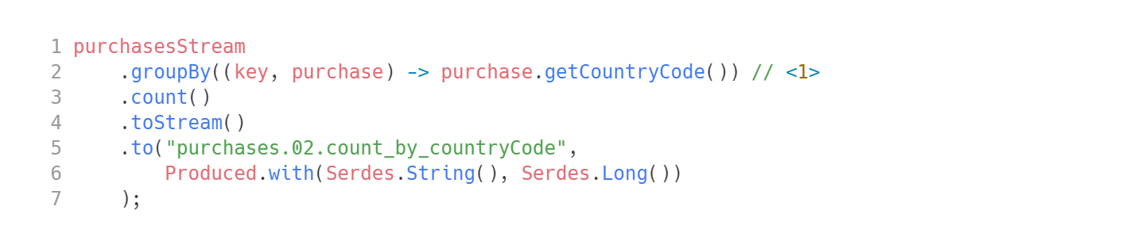
Grouping example 2
Kafka Streams
Count the number of purchases by country
1. Triggers a repartition. This operation will automatically introduce an intermediate topic.

Slide 42
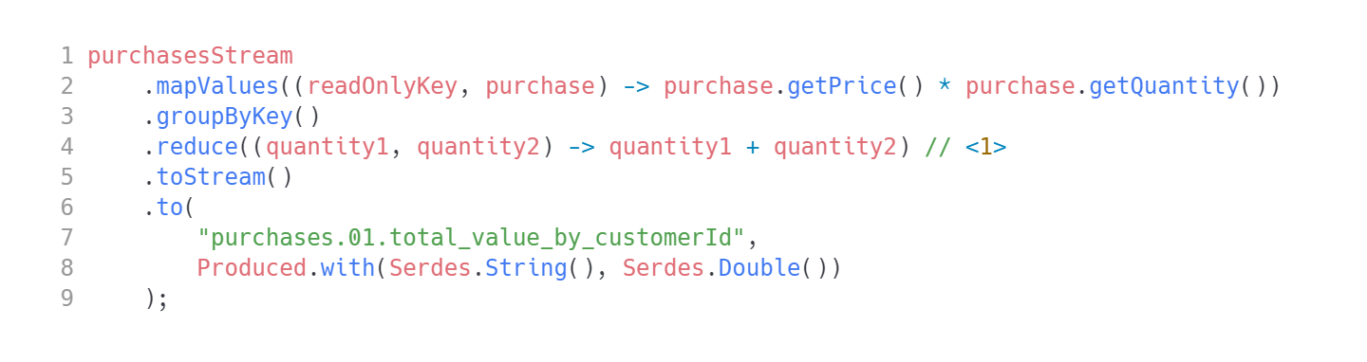
Grouping example 3
Kafka Streams
Calculate total purchase value for each customer
1. Reduce operation takes 2 event values and produces a new value of the same type.

Slide 43
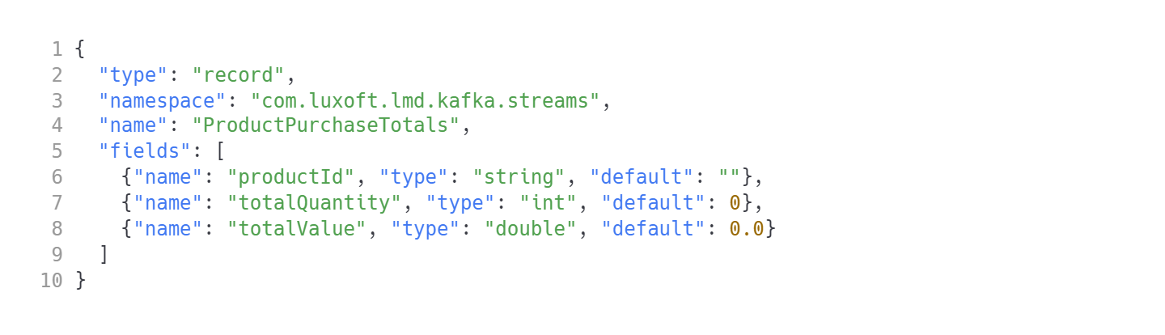
Grouping example 4
Kafka Streams
Calculate total purchase value and quantity sold for each product
This will be most difficult. We need to introduce a new record type.
purchase-totals.avsc

Slide 44
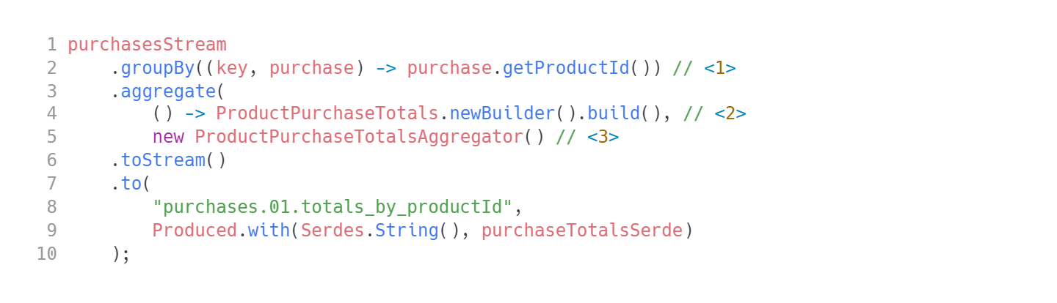
Grouping example 4
Kafka Streams
Calculating ProductPurchaseTotals requires .aggregate()
1. Different key is required
2. Initial aggregation state
3. Aggregation logic. Could be a lambda, but we will use a separate class. Implement org.apache.kafka.streams.kstream.Aggregator.

Slide 45
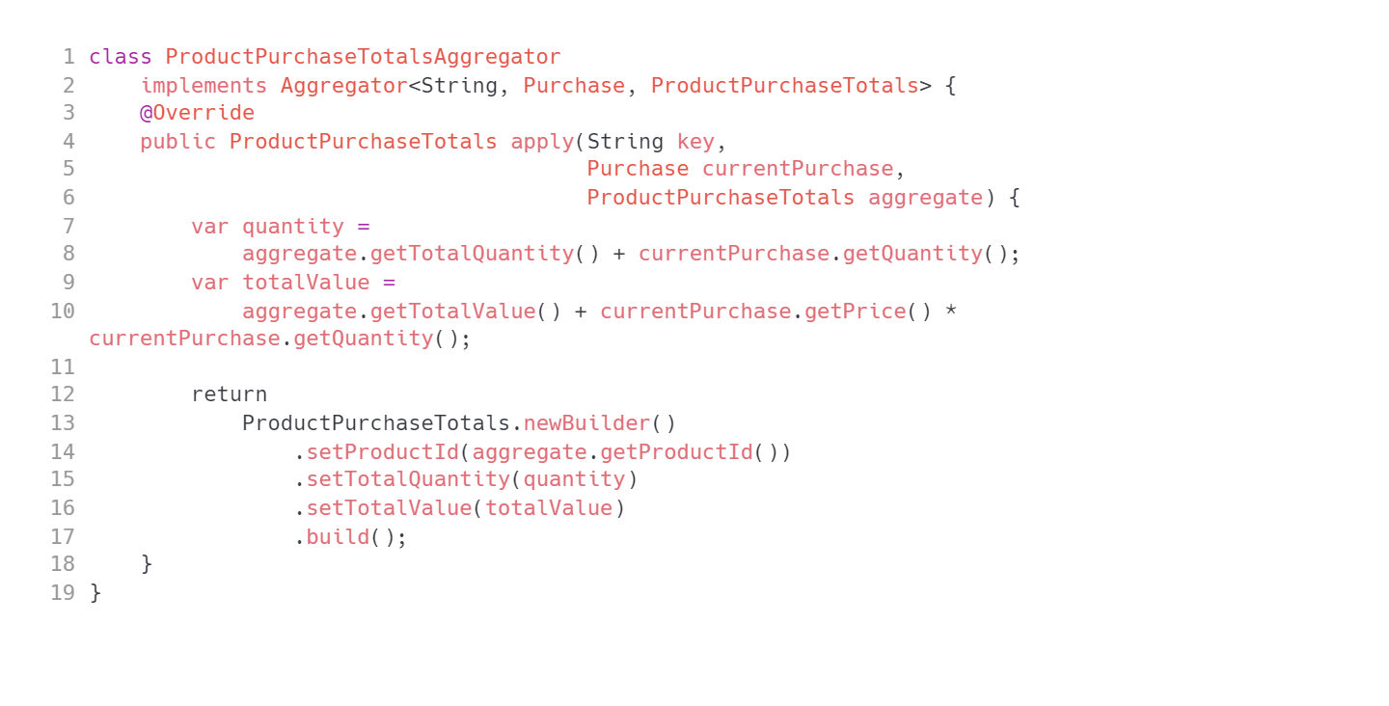
Grouping example 4
Kafka Streams

Slide 46
Data locality
Kafka Streams
Data locality is critical for performance.
Key/value lookups are very fast but the added network latency is a serious bottleneck
The stateful processor should ONLY use a local store
No data is shared between processors
If one processor fails it has no impact on other processors

Slide 47
Failure recovery and fault tolerance
Kafka Streams
Each processor has a local state store
Each state store is backed up by changelog topic in Kafka to back up the store state
That does not look like it's performant...
Actually it is:
Records are produced in batches
Commits are not sent for every records, these are time based
Only the last values are sent for some particular key
The changelog topics are compacted

Slide 48
Processing guarantees
Kafka Streams
At-least-once semantics
Records are never lost but may be redelivered. If your stream processing application fails, no data records are lost and fail to be processed, but *some data records may be re-read and therefore re-processed*.
At-least-once semantics is enabled by default (processing.guarantee="at_least_once") in your Streams configuration.
Exactly-once semantics
Records are processed once. Even if a producer sends a duplicate record, it is written to the broker exactly once. Exactly-once stream processing is the ability to execute a read-process-write operation exactly one time. All of the processing happens exactly once, including the processing and the materialized state created by the processing job that is written back to Kafka.
To enable exactly-once semantics, set processing.guarantee="exactly_once_v2" in your Streams configuration.

Slide 49
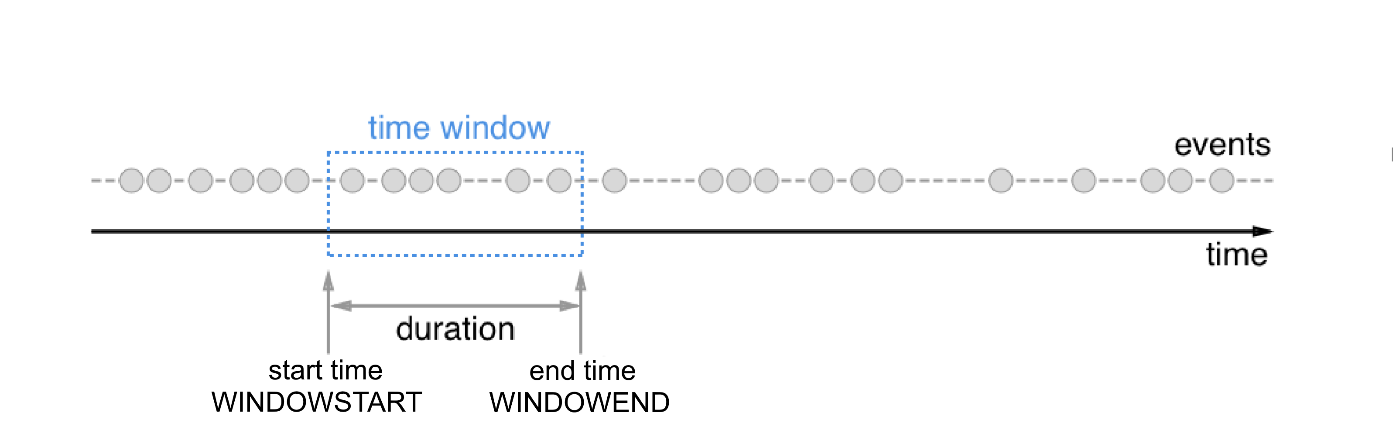
Windowed aggregation
Kafka Streams
Exactly-once semantics
Records are processed once. Even if a producer sends a duplicate record, it is written to the broker exactly once. Exactly-once stream processing is the ability to execute a read-process-write operation exactly one time. All of the processing happens exactly once, including the processing and the materialized state created by the processing job that is written back to Kafka.
To enable exactly-once semantics, set processing.guarantee="exactly_once_v2" in your Streams configuration.
Splitting the stream into the "buckets" of finite size over distinct period of time.
TIP: Kafka Stream supports only time based Windowing. Other frameworks might provide other bucketing implementations (Apache Flink: record count).
CAUTION: You cannot process data in windowed manner in Kafka Streams without grouping by key.
Other frameworks (Flink) have that ability.

Slide 50
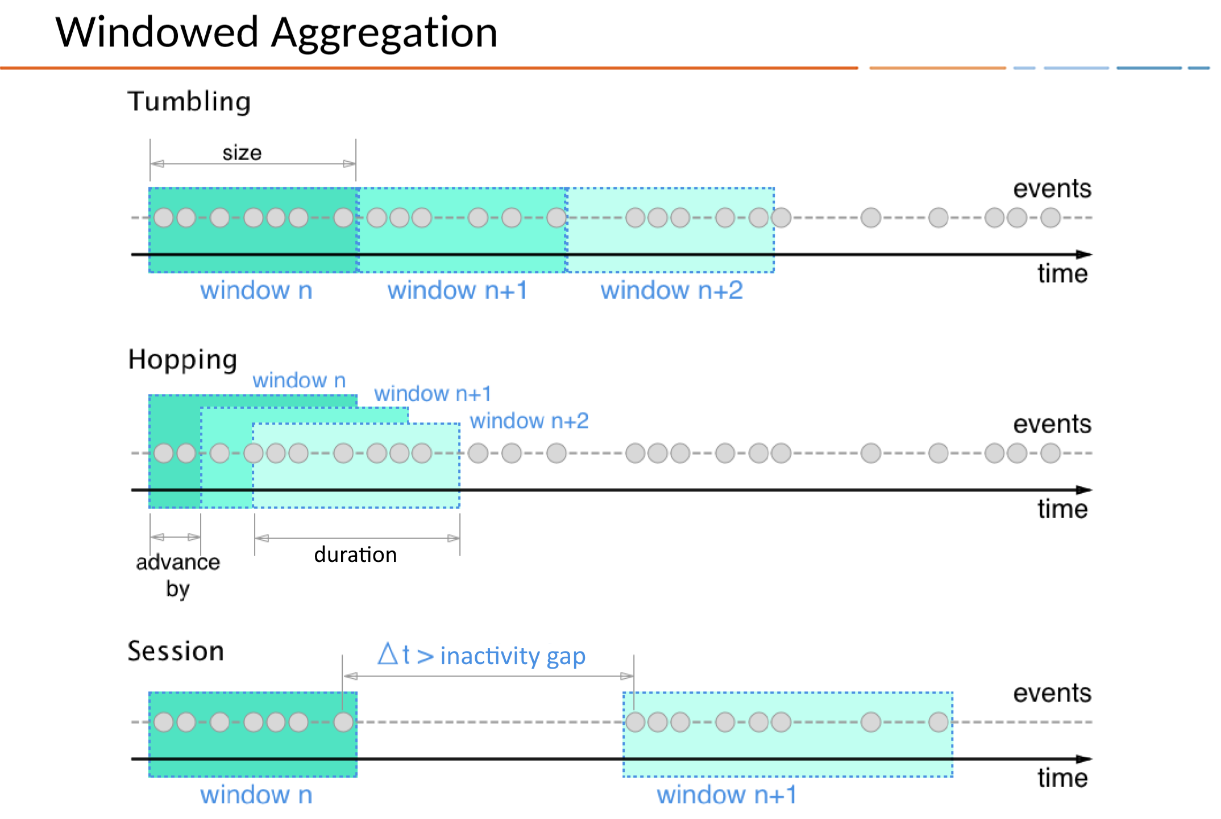
Windowed aggregation
Kafka Streams
Exactly-once semantics
Records are processed once. Even if a producer sends a duplicate record, it is written to the broker exactly once. Exactly-once stream processing is the ability to execute a read-process-write operation exactly one time. All of the processing happens exactly once, including the processing and the materialized state created by the processing job that is written back to Kafka.
To enable exactly-once semantics, set processing.guarantee="exactly_once_v2" in your Streams configuration.

Slide 51
Windowed aggregation
Kafka Streams
Exactly-once semantics
Records are processed once. Even if a producer sends a duplicate record, it is written to the broker exactly once. Exactly-once stream processing is the ability to execute a read-process-write operation exactly one time. All of the processing happens exactly once, including the processing and the materialized state created by the processing job that is written back to Kafka.
To enable exactly-once semantics, set processing.guarantee="exactly_once_v2" in your Streams configuration.

Slide 52
Windowed aggregation
Kafka Streams
Exactly-once semantics
Records are processed once. Even if a producer sends a duplicate record, it is written to the broker exactly once. Exactly-once stream processing is the ability to execute a read-process-write operation exactly one time. All of the processing happens exactly once, including the processing and the materialized state created by the processing job that is written back to Kafka.
To enable exactly-once semantics, set processing.guarantee="exactly_once_v2" in your Streams configuration.

Slide 53
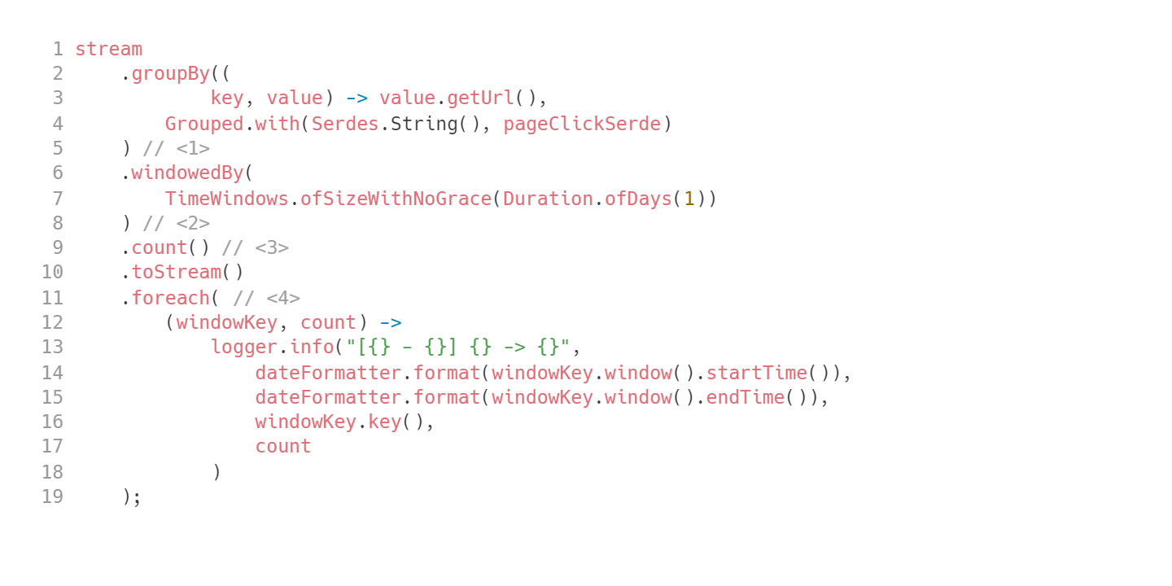
Windowing example
Kafka Streams
Count page clicks for each URL every day.
Group first. This one repartitions!
Setup window configuration. Let's not mention that grace just yet.
Aggregation logic.
Display results grouped both by key and day.

Slide 54
Time in Kafka Streams
Kafka Streams
Event time - the moment in time the event actually happened.
Ingestion time - timestamp set by the broker while registering the event
Processing time - the point in time the event happends to be processed by stream processing application. This might be days after the event time.
Stream time - The maximum timestamp seen over all processed records so far. Kafka Streams tracks stream-time on a per-task basis.
TIP: No new messages - the time does NOT advance!

Slide 55
TimestampExtractor
Kafka Streams
Kafka Streams assigns a timestamp to every data record via so-called timestamp extractors.
You may:
use input record timestamp to advance streams time.
use wall clock to advance streams time
write your own TimestampExtractor that extracts the timestamp from event payload.

Slide 56
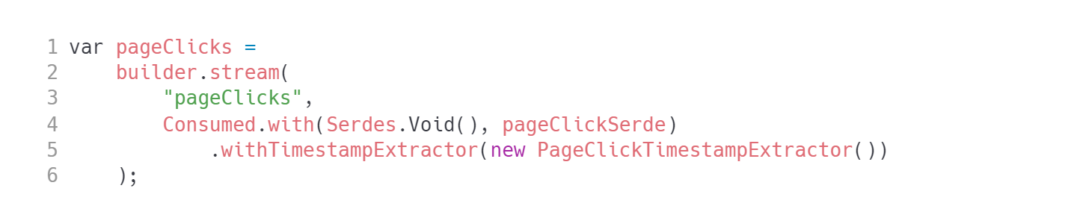
TimestampExtractor
Kafka Streams

Slide 57
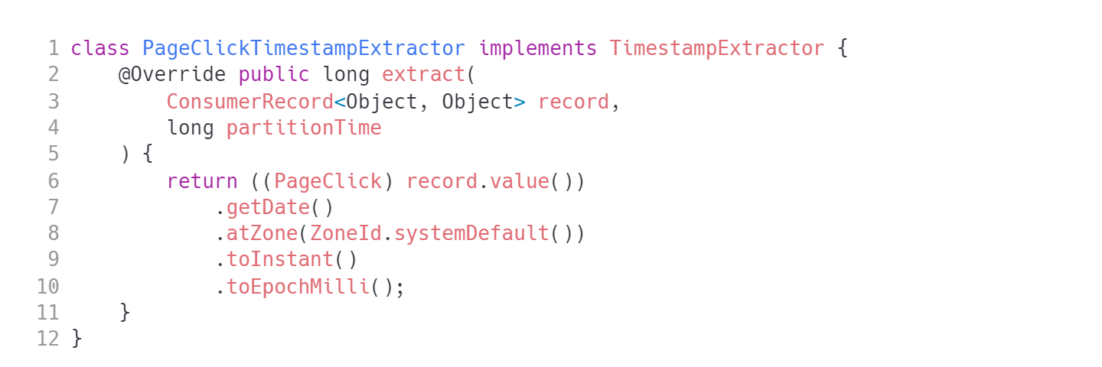
TimestampExtractor
Kafka Streams

Slide 58
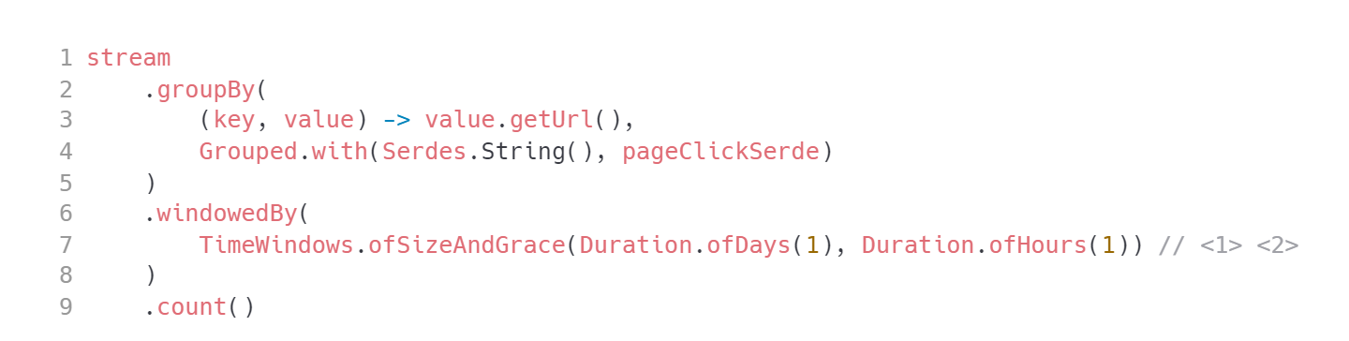
Windowing - grace
Kafka Streams
Let’s discuss out-of-order messages
This windows specifies a grace time of 1 hour. Events 'late' more than 1h will be simply discarded.
After a grace period window results are final.

Slide 59
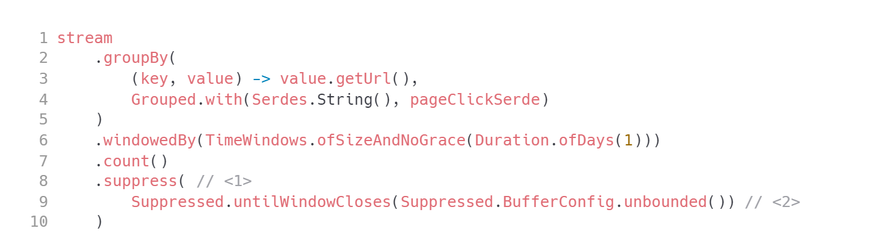
Windowing – suppressing events
Kafka Streams
What if you need only the final result of a window (no intermediate results)?
Use .suppress() operator.
The results need to be cached. Choose your strategy wisely or you may end up with OOME or performance problems.

Slide 60
KStream vs. KTable
Kafka Streams
Stream models an event stream. Every event matters. i.e.: Purchases, Stock price quotes
Table models an update stream. The update stream requires event key. We are mostly interested in the latest value for some key (hence the update stream). i.e. : current customer contact info, Current stock price.
There is a notion of duality between those two: you can turn an event stream into the update stream and vice versa.
TIP: we can use compacted topic for storing changelogs

Slide 61
How to create a KTable
Kafka Streams
use builder.table(topicName, Materialized)
convert any existing update stream using .toTable(Materialized)
use grouping with any kind of aggregation.
NOTE: It looks like you have already built tables. You just did not know about it.
TIP: every KTable obviously is backed up by a state store.

Slide 62
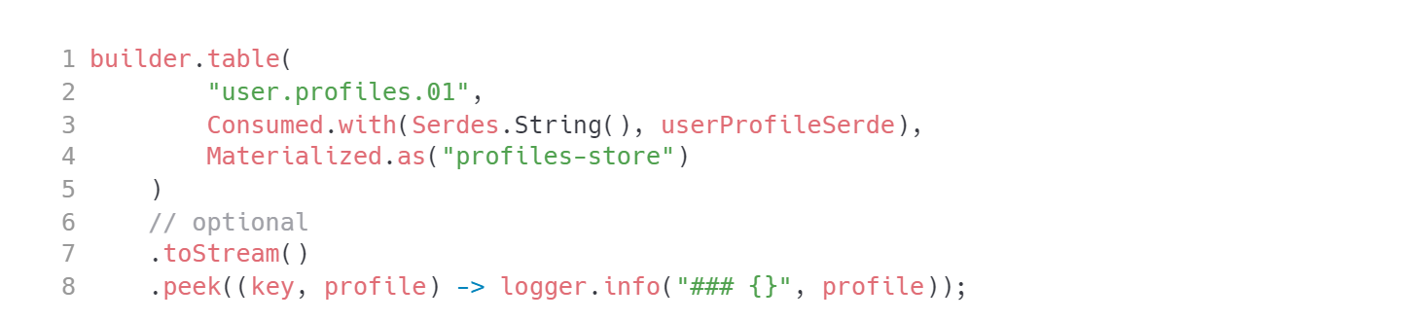
KTable - example
Kafka Streams

Slide 63
Interactive Query support
Kafka Streams
Interactive Queries allow you to treat the stream processing layer as a lightweight embedded database, and to directly query the latest state of your stream processing application. You can do this without having to first materialize that state to external databases or external storage.
Interactive Queries simplify the architecture and lead to more application-centric architectures.

Slide 64
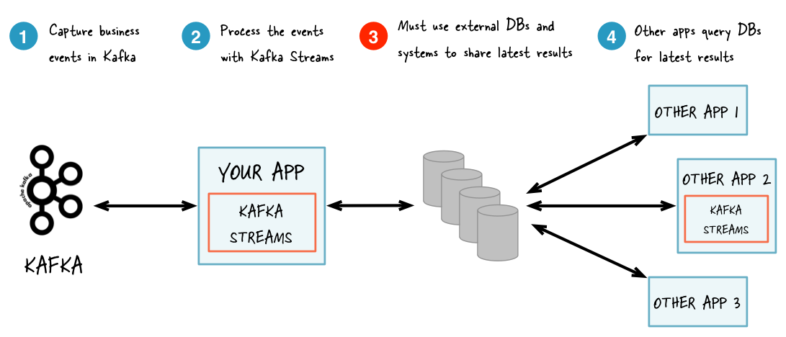
Interactive Query
Kafka Streams
Architecture without interactive queries

Slide 65
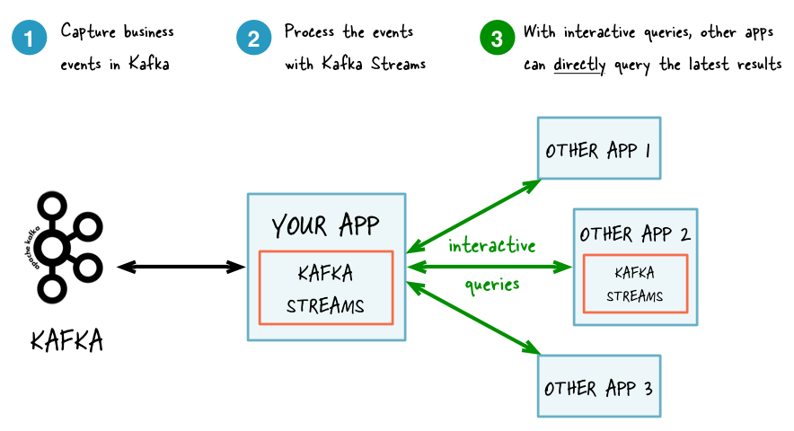
Interactive Query
Kafka Streams
Architecture with interactive queries

Slide 66
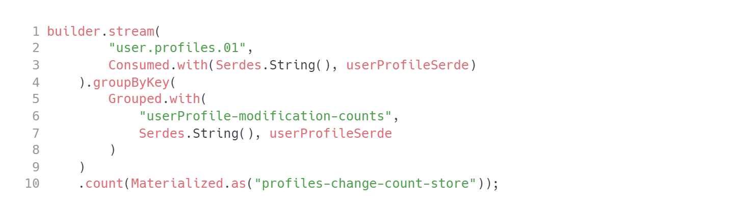
KTable – example 2
Kafka Streams
TIP: Browse example code on how you can access a state store and expose it via REST API.

Slide 67
KTable – factors to consider
Kafka Streams
KTable emits data to downstream, simply less frequently. There are some driving factors which will influence the rate of emission:
How many unique keys do you have?
How high is the rate of inbound events?
Config params: cache.max.bytes.buffering and commit.interval.ms
CAUTION:
cache.max.bytes.buffering=0 will turn your KTable into a stream.
commit.interval.ms forces cache flush, sending the records downstream.

Slide 68
Joins
Kafka Streams
A join operation merges two input streams and/or tables based on the keys of their data records, and yields a new stream/table.
The join operations available in the Kafka Streams DSL differ based on which kinds of streams and tables are being joined; for example, KStream-KStream joins versus KStream-KTable joins.

Slide 69
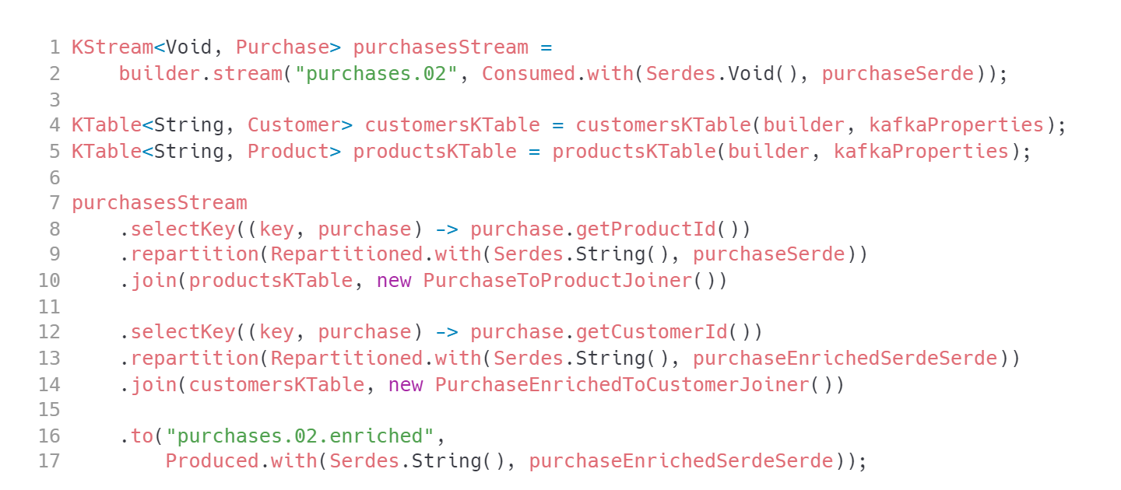
KStream to KTable joins
Kafka Streams
Enriching your messages
NOTE: We have to discuss this in code. That is already too complex for a single slide.

Slide 70
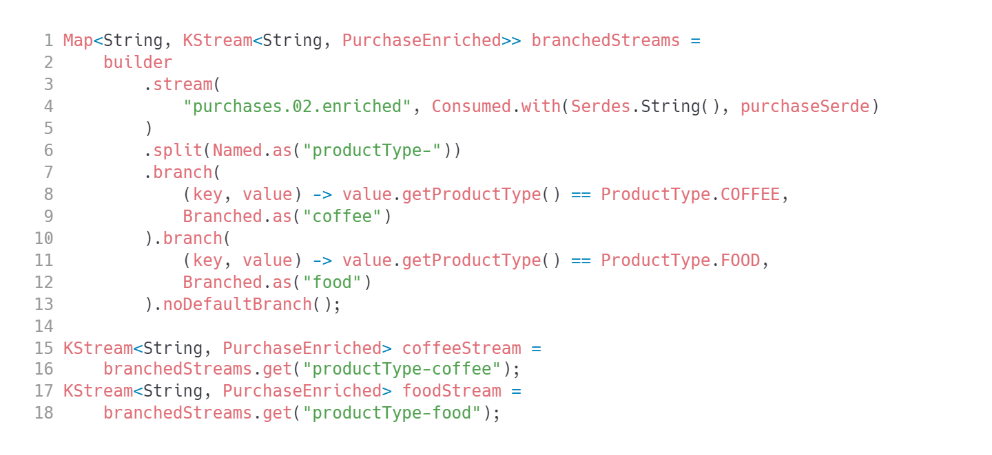
KStream to KStream joins
Kafka Streams
Detecting events that happened around same time

Slide 71
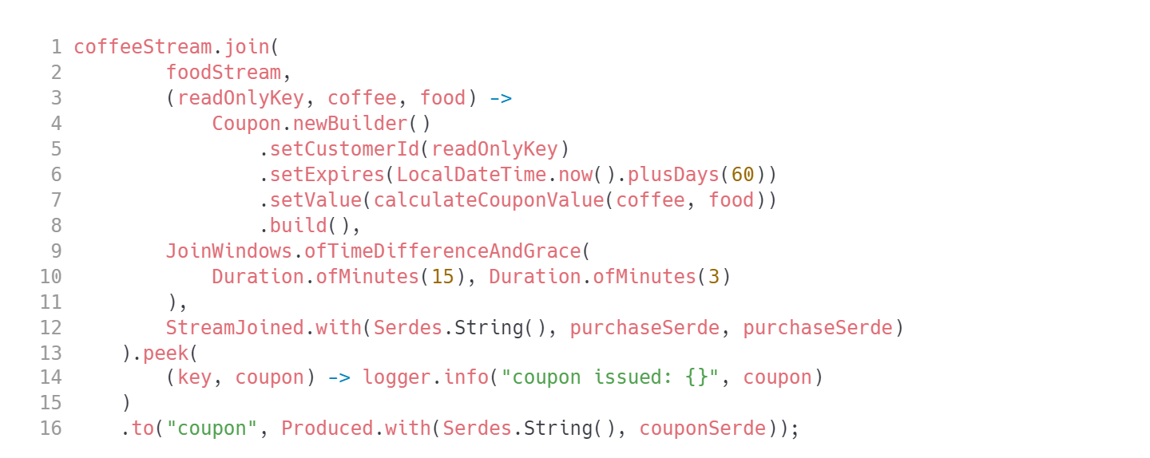
KStream to KStream joins
Kafka Streams
Detecting events that happened around same time

Slide 72
Links
Kafka Streams
https://docs.confluent.io/platform/current/streams/concepts.html
https://www.oreilly.com/content/why-local-state-is-a-fundamental-primitive-in-stream-processing/
https://www.lydtechconsulting.com/blog-kafka-streams-testing.html
Kafka Streams vs Flink:
https://dzone.com/articles/kafka-stream-kstream-vs-apache-flink
https://www.openlogic.com/blog/apache-flink-vs-kafka-streams
https://www.confluent.io/blog/apache-flink-apache-kafka-streams-comparison-guideline-users/
Exactly once processing:
https://medium.com/lydtech-consulting/kafka-streams-transactions-exactly-once-messaging-82194b50900a
https://www.confluent.io/blog/exactly-once-semantics-are-possible-heres-how-apache-kafka-does-it/
Kafka Streams issues:
https://smartcat.io/blog/data-engineering/problem-with-kafka-streams/
https://aseigneurin.github.io/2018/08/27/kafka-streams-processing-late-events.html

Slide 73


Questions?
73
Notes:
The final slide of the course is for answers to any remaining questions of participants.
Font requirements:
Title font: Arial (Headings), bold, white, 60 size.

Slide 74
Thank you!
Please share your feedback. Your opinion is important to us!
Notes:
The final slide of the course is for answers to any last questions of the participants.
Font requirements:
Title font: Arial (Headings), bold, white, 54 size.

